Slide 1

Sexually Transmitted Diseases

Slide 2
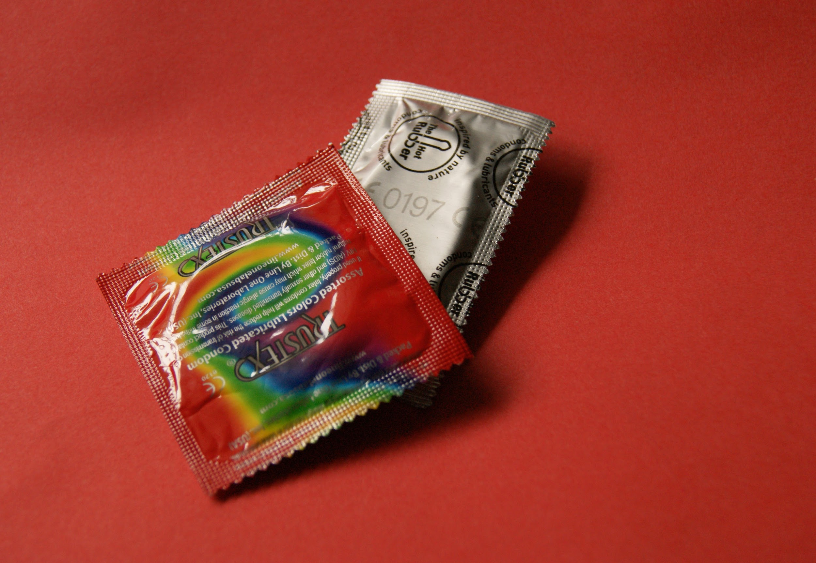
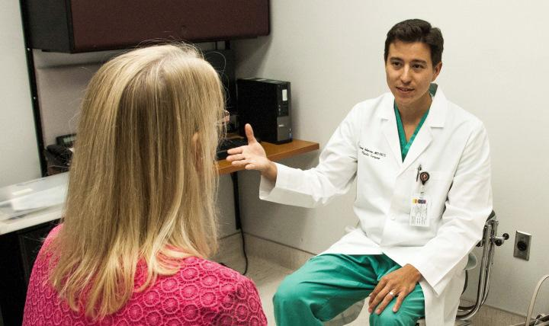
How to Prevent STD`s

Slide 3
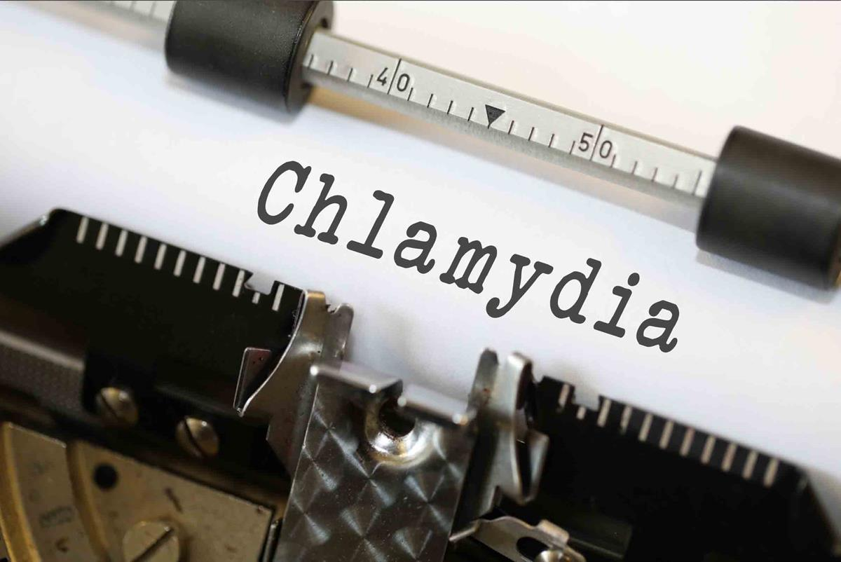
Notes:
Chlamydia is the leading cause of STD`S in females and males in both developed and undeveloped countries, with more than 110 million cases

Slide 4


Slide 5
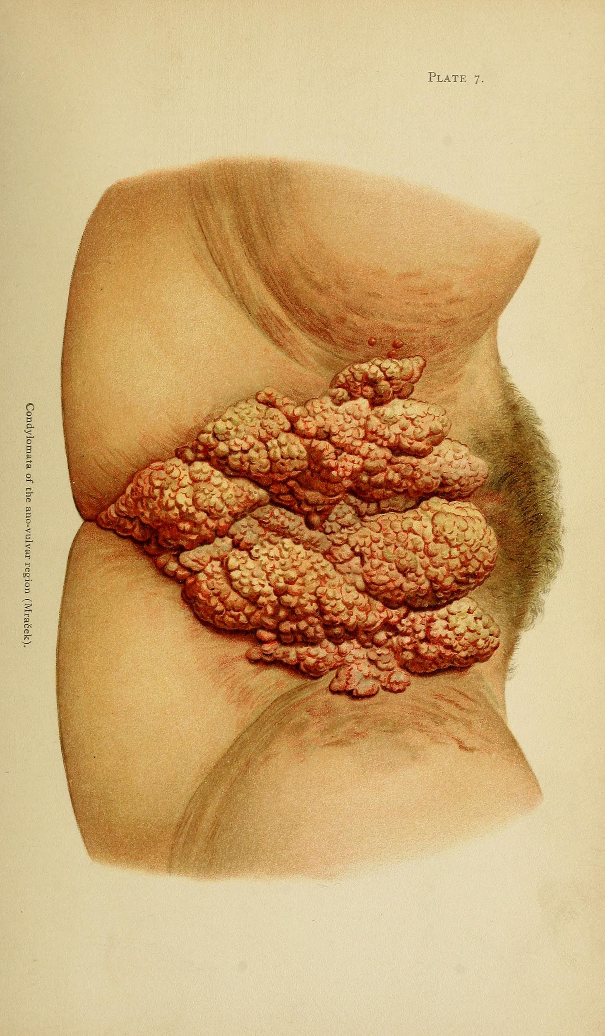
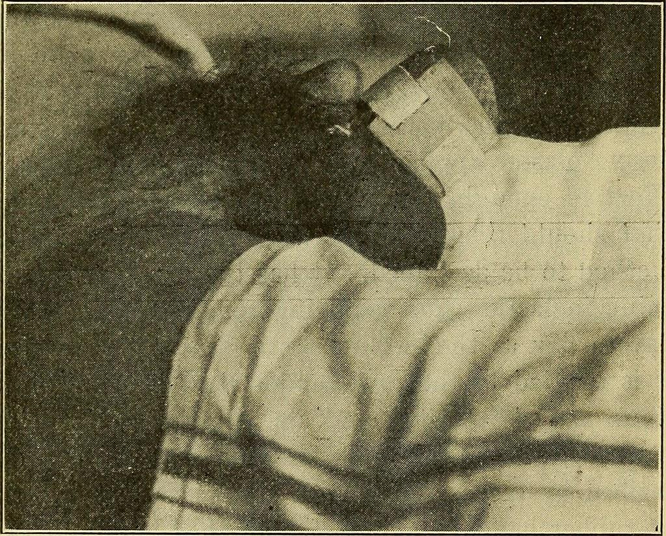
Gonnorrhea, Syphillis and Chlaymydia
According to the CDC young people in the U. S aged 15-24 represent 27% of the total of sexually active population but account for 50% of new STI`s.

Slide 6
Myocoplasma
Is recognized as a male urethis and also is now showing evidence in women. According to the Scientifica mycoplasma is a slow growing organism that has a uniformed detection of acute infection and prior exposure. Isolation and culturing of M. genitalium is slow and time consuming , and not feasible when there is a need to institute immediate antimicrobial therapy.

Slide 7
Treatment
M. Genitalium is an emerging STI, more research is needed regarding pathogenicity and treatment.

Slide 8


Slide 9

Resources
Local Health Dept.
Primary Care Doctor
Local Emergency Room
Campus Health Suite

