Slide 1
PSTD SYMPTOMS
Anger
Depression
lack of trust
fatigue
Notes:
There are so many different symptoms that a person that is struggling with PSTD suffers with. This disorder is caused by trauma whether it is from being in the services and having to experience war, sexual assault and even medical trauma.

Slide 2
PSTD CAUSES
TRAUMETIC EVENT
SEXUAL ASSAULT
LOSS OF A LOVE ONE
LOSS OF EMPLOYMENT
This Photo by Unknown Author is licensed under CC BY-NC-ND
Notes:
The causes of PSTD can stem from so many events in life that has effected some one. PTSD can involve direct exposure to one or more of these events, witnessing such an event, or hearing about someone close to them experiencing such an event.

Slide 3
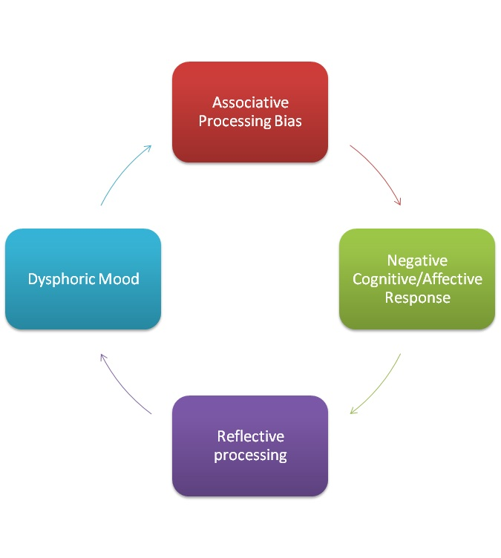
Cognitive Processing Therapy
This Photo by Unknown Author is licensed under CC BY-SA
Notes:
Treatment begins with psychoeducation regarding PTSD, thoughts, and emotions. The patient becomes more aware of the relationship between thoughts and emotions and begins to identify “automatic thoughts” that may be maintaining the PTSD symptoms. The patient writes an impact statement that details current understanding of why the traumatic event occurred and the impact it has had on beliefs about self, others, and the world.

Slide 4
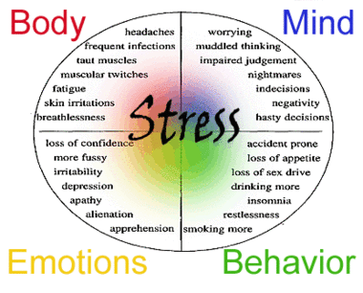
Prolonged Exposure
This Photo by Unknown Author is licensed under CC BY-SA
Notes:
Prolonged exposure is a specific type of cognitive behavioral therapy that teaches individuals to gradually approach trauma-related memories, feelings, and situations. Individuals work with their therapist in a safe, graduated fashion to face stimuli and situations that evoke fear and remind them of the trauma to increase their comfort and reduce their fear.

Slide 5
A Dynamic Model of Post-Traumatic Stress Disorder for Military Personnel and Veterans
Notes:
The model includes both military personnel and veterans in a “system of systems.” This is a novel aspect of our model, since many policies implemented at the military level will potentially influence (and may have side effects on) veterans and the Department of Veterans Affairs. The model is first validated by replicating the historical data on PTSD prevalence among military personnel and veterans from 2000 to 2014 (datasets from the Department of Defense, the Institute of Medicine, the Department of Veterans Affairs, and other sources).

Slide 6
Reference
PLOS ONE, 2019: Retrieved on February 27, 2020 from https://journals.plos.org/plosone/article?id=10.1371/journal.pone.0161405
PTSD, 2020: Prolonged Exposure, Retrieved on February 27, 2020 from https://www.apa.org/ptsd-guideline/treatments/prolonged-exposure

