Slide 1



Encouraging a positive human factors culture
BY Aaron Pennington

Slide 2
A brief intro:
Human elements are basically the outside or outer components that impact a pilot's presentation genuinely or mentally. These components can influence pilot's dynamic in various situations and capacity to relieve hazard. “The unintended part will be the most relevant from Human Factors point of view. When automation and screens began to appear in planes, basic instruments were compulsory. The idea behind this requirement was clear, and could be explained in these terms: Everything is fine, but we don’t fully trust the new systems. If something fails, you must be able to go back to a former development stage and solve the problem the old way. An experienced old-school pilot rephrased this principle in a funny way: “Give me a plane as automated as you want, as long as it has a big yellow button that converts it into a DC9,
Sanchez-Alarcos, 2019).”

Slide 3

WHAT ARE THEY?
THE DISCIPLINE THAT DEALS WITH HUMAN-MACHINE INTERFACE
MENTAL, SOCIAL, PHYSICAL, AND BIOLOGICAL SAFETY CHARACTERISTICS OF INDIVIDUAL GROUPS WITHIN OPERATIONS.
STUDIES THE ENVIRONMENTAL FACTORS THAT CORRELATE DIRECTLY WITH PERFORMANCE.
HUMAN FACTORS INTERPRETED

Slide 4

IS HAVING A POSITIVE CULTURE IMPORTANT TO HUMAN FACTORS?
CONTROLLED EXPERIMENTS, DATA COLLECTION AND RESEARCH CONTRIBUTE TO AVIATION SAFETY, TRAINING AND FLIGHT OPERATIONS
Spares LIVES, INCREASES OPERATIONAL EFFICIENCY, AND MINIMIZES EXCESSIVE SPENDING
Directs A TIMELINE OF HUMANS ABILITY TO SUSTAIN TECHNOLOGICAL DESIGNS THAT MEET EVOLVING DEMANDS OF AVIATION

Slide 5

TEAM WORK’S IMPORTANCE
Preparing CREWS INSTEAD OF INDIVIDUALS
Imperfect CREW INTERACTIONS WERE CONTRIBUTING TO HUMAN ERROR IN THE SKIES
STUDIES PROMPTED EMPHESIS ON DEVELOPING CREW BEHAVIORS AND INGRAINED TECHNICAL SKILLS REQUIRED TO CARRY OUT FLIGHT PROCEDURES.
CRM(CREW RESOURCE MANAGEMENT)
Data sources, PROCESS, & OUTPUTS
Group COMPOSITION, COHESIVENESS AND ORGANIZATIONAL STUCTURE INFLUENCE CREW BEHAVIORS (INPUTS)
FACTORS WHICH CONTRIBUTE TO CREW’S SUCCESS

Slide 6
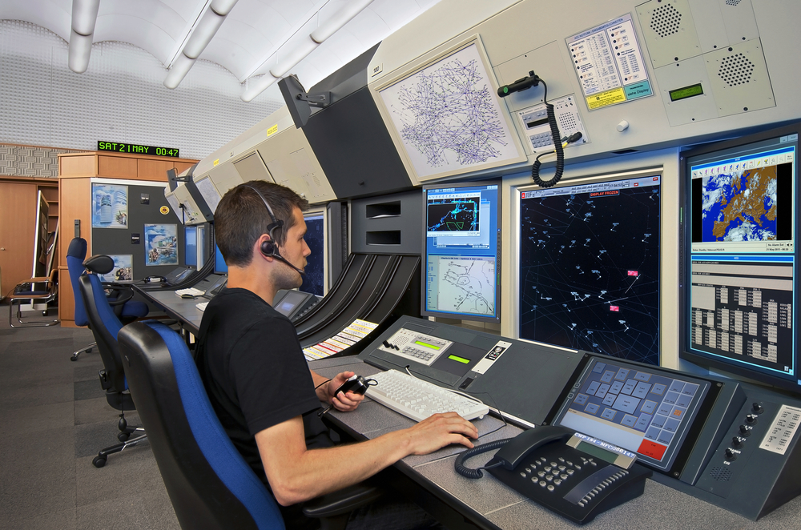

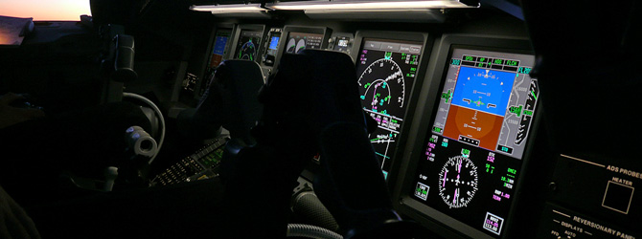
ADVANCES
IN TECHNOLOGY
Activities FOR TRAINING
Using AUTOMATION
COCKPIT INSTUMENTATION
LOFT(LINE ORIENTED FLIGHT TRAINING)
LOSA (LINE OPERAIONS SAFETY AUDIT)
ASAP (AVIATION SAFETY ACTION PLAN)
TCAS (TRAFFIC ALERT AND COLLISION AVOIDANCE SYSTEM)

Slide 7
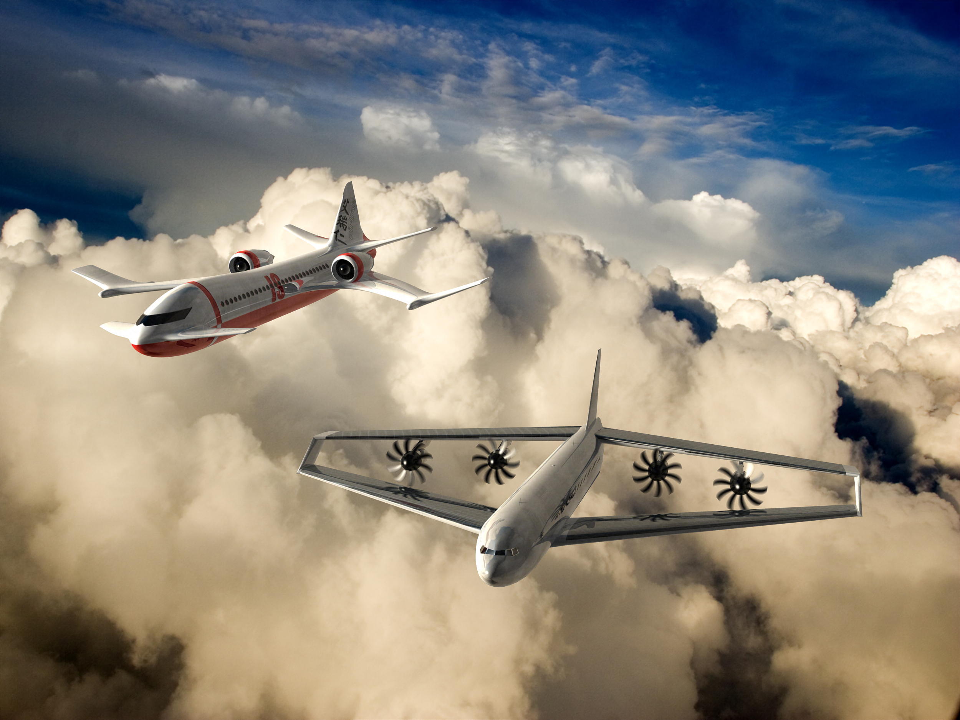


FUTURE GENERATIONS
FAA INITIATIVE TO CHANGE THE NATURE, NECESSITY, AND FREQUENCY OF INTERACTION BETWEEN PILOT AND AIR TRAFFIC CONTROL
Move FROM GROUND BASED TO SATELLITE BASED REAL TIME UPDATE
HUMAN FACTORS INCREASINGLY CONSIDERED DURING DESIGN PROCESS OF AVIATION SYSTEMS
WILL BE USED TO PROFESSIONALLY ACCESS AND RECOMMND ACTION
NEW TECHNOLOGY, ROLE RESPONSIBILITY, CREW INTERACTION TRAINING, ORGANIZATIONAL STRUCTURE ETC.

Slide 8
REFRENCES
Sanchez-Alarcos, Jose. Aviation and Human Factors : How to Incorporate Human Factors into the Field, CRC Press LLC, 2019. ProQuest Ebook Central, http://ebookcentral.proquest.com/lib/erau/detail.action?docID=5793708.
Created from erau on 2020-04-26 12:45:04.
Weiner, E. L., & Nagel, D. C. (1988). Human Factors in Aviation. San Diego, CA, Academic Press, Inc.

