Slide 1
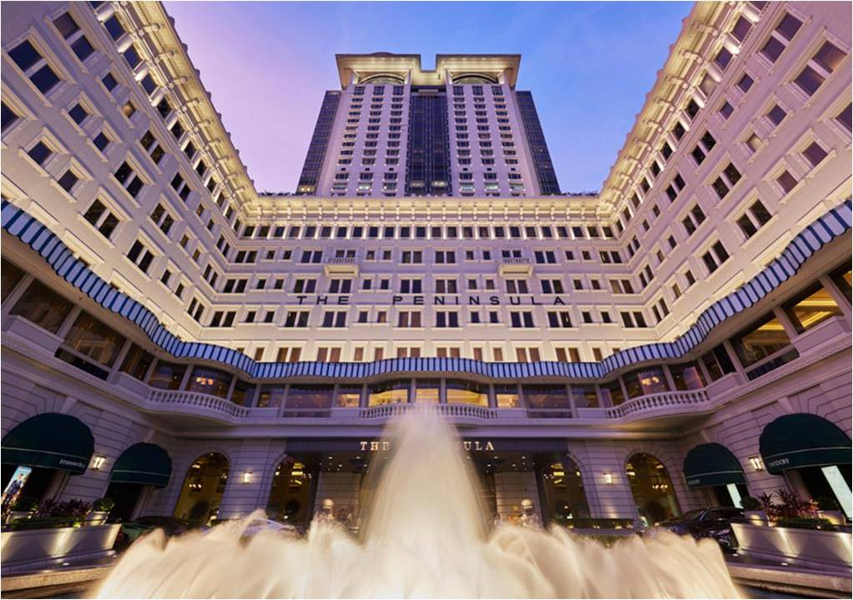
Marketing and Customer Experience Management
Peninsula Hong Kong

Slide 2
2. Introduction
Peninsula Hotel is the most luxuries facility in Hong Kong and for many other parts of Asia (Hsu, 2015).
The hotel is focused in giving their customers experience worth every penny they pay for.
Technology is slowly changing the levels of experiences and Peninsula Hotel is at forefront adopting live improving technology services.

Slide 3
3. Competitive advantages
Use of virtual reality in making bookings.
-This helps the customer make an informed decision.
Virtual reality with minimize the hustle of calling to inquire the size of the rooms, amenities, and surroundings (Wang, Li & Zhang, 2016).

Slide 4
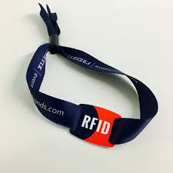
4. Competitive advantages
Use of AI (artificial intelligence) technology together with a sound technology to increase personalized services to customers.
Use of RFID Wristband able to store customer details for accessing amenities and making payments.
RFID Wristband

Slide 5
5. Improving customer experience
The hotel is keen to implementing recommendation of the market audit.
The improvements are target for sales and after-sale services, where customers tend to voice their concerns and dissatisfaction.

Slide 6
6. Improving customer experience
The hotel is focused in making face-recognition a reality.
This technology would save customer the time it takes to check-in their rooms.
The technology is expected to direct the customer to their respective rooms and open the door using the same technology.

Slide 7
7. Financial Impact
Improvements require a certain amount of investment, either in monetary value or time.
Decisions on improving experience are usually arrived at after a market research and intense consultations (Mohammed, Guillet & Law, 2014).
The number of steps help cushion spending on otherwise unproved strategies.

Slide 8
8. Conclusion
Peninsula Hotel recognizes the reason for improving customer experience as a competitive advantage.
The modern travels consist of tech-savvy enthusiast whose expectations on experience in five star hotels is more personalized.
Investing in customer experience is a guaranteed strategy is well analyzed at the market level.

Slide 9
9. Appendices
Hsu, H.C.C., 2015. Tourism and hospitality education in Asia. The Routledge handbook of tourism and hospitality education, pp.197-209.
Mohammed, I., Guillet, B.D. and Law, R., 2014. Competitor set identification in the hotel industry: A case study of a full-service hotel in Hong Kong. International Journal of Hospitality Management, 39, pp.29-40.
Wang, Y.S., Li, H.T., Li, C.R. and Zhang, D.Z., 2016. Factors affecting hotels' adoption of mobile reservation systems: A technology-organization-environment framework. Tourism Management, 53, pp.163-172.

