Slide 1

Current Supply Chain Technologies

Slide 2




Introduction
There are several new technologies and emerging trends in supply chain management:
  Hyped Technologies - 5G and Blockchain (Banker, 2020).
  Promising technologies - Artificial Intelligence (AI)/Machine Learning (ML) Platforms, Autonomous Trucking, Digital Twin Model Builders (Banker, 2020).
  High Value technologies - Next Generation Control Towers, Robotic Automated Storage and Retrieval, Robotic Process Automation (RPA) (Banker, 2020).
Supply chain trends in technology are transforming the way business is conducted, and it will continue to evolve well into the future.

Slide 3
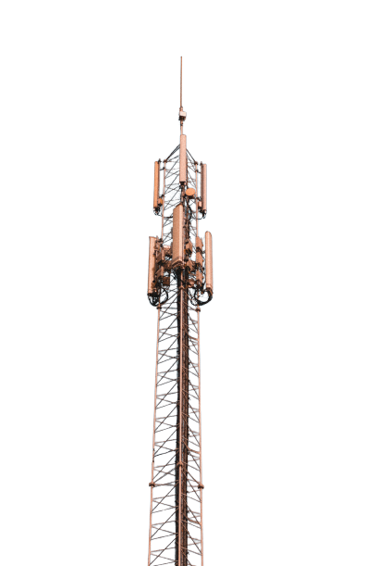


The fifth generation of wireless technology -latency will drastically decrease(Banker, 2020).
Will produce an incredibly rich data stream within the supply chain management resulting in faster warehouse movements, consolidation, distribution and delivery of re-supplies (Banker, 2020).
Enhanced communication and engagement value to customers within supply chain (Banker, 2020).
5G
Technology
Hyped Technologies
Blockchain
Technology
Solid remedy for authentication or to provide reimbursement to connected supply chain participants after their portion in a chain of integrated operations has been accomplished(Banker, 2020).

Slide 4
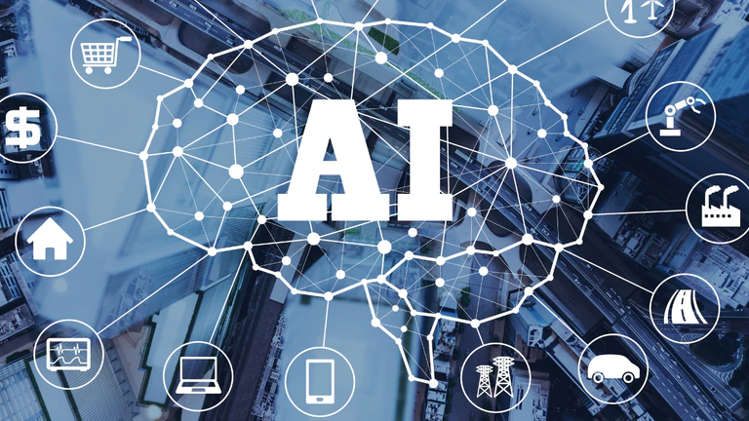
Promising technologies
Artificial Intelligence (AI)/Machine Learning (ML) Platforms - the application of data that provide useful forecasts for their businesses with machine learning algorithms and AI technologies. Expertise in supply chain operations for logistics services suppliers is how they distinguish themselves and use of personalized AI/ML implementation make logical sense (Banker, 2020).
Autonomous Trucking – the focus is on delivering across targeted lanes for customers. Autonomous trucks on the road will provide supply chain companies with high Return on Investment – ROI (Banker, 2020).
Digital Twin Model Builders - A graph database-based AI expert system to help automate the interactive twin chain formation. Greatly required in supply chain planning (SCP) solutions – this technology will significantly help in speeding up model building and SCP implementations, including full representation of financials as they are incurred by the business(Banker, 2020).

Slide 5

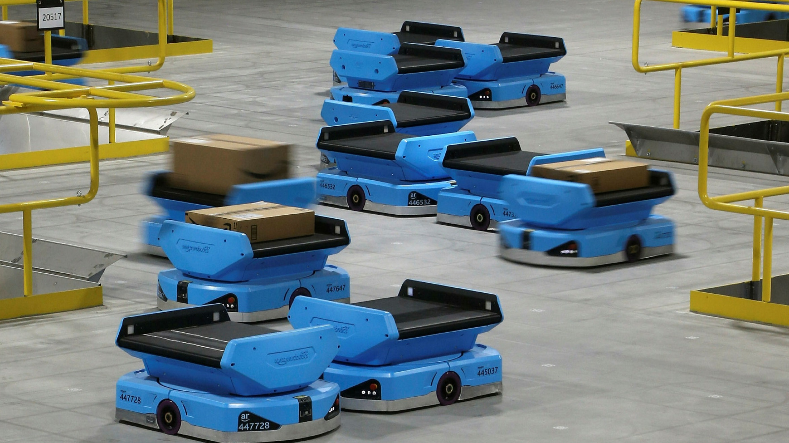
High Value Technologies
Next Generation Control Towers – on a cross-functional, automated end-to-end supply chain tower is a versatile distribution network control room designed to model shipping, storage, manufacturing restraints and then create streamlined plans to accommodate unavoidable exceptions (Banker, 2020).
Robotic Automated Storage and Retrieval - gives high processing capacity and high consistency thanks to the dynamic movement of the machines which eliminates limitations in terms of output and sequence and have an increased productive potential for the same day online orders are carried out (Banker, 2020).
Robotic Process Automation (RPA) - for optimizing large, recurrent activities in the supply chain in high-volume automation and the examination by carrier websites for the timing of appointments computational preparation efficiency (Banker, 2020).

Slide 6
References
Banker, S. (2020). 2021 Supply Chain Technology Trends To Watch. Forbes. https://www.forbes.com/sites/stevebanker/2020/12/21/2021-supply-chain-technology-trends-to- watch/?sh=4b96cd0e3ad6

Slide 7


THANK YOU

