Slide 1

GOOGLE COMPANY ANALYSIS
AND
RECOMMENDATIONS
Agenda
Company Overview
Summary of SWOT
Recommendations:
  Improve its competitive advantage
  Enhance customers' satisfaction
  Establish new markets
Conclusion

Slide 2
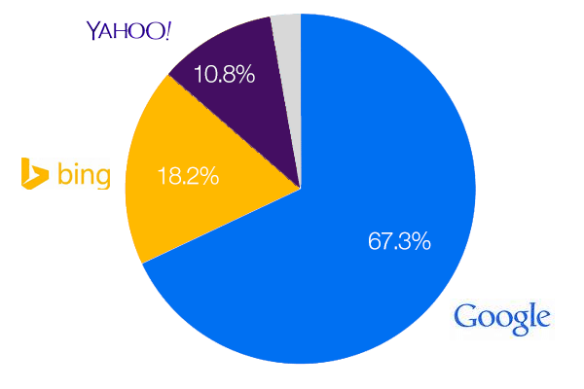
Company overview
Google company was founded in 1998
Its founders were page larry and brin sergey
Google mission focus on proprietary algorithms:
  Information availing and accessibility
The main competitor of google company are:
  Apple
  Microsoft
Notes:
Google Company is a multination technological firm in the United States. Its primary product and services are internet-related such as search engines, computer applications, online marketing, and cloud computing (Hassler, 2020). The foundation of Google Company was triggered by two Ph.D. students at Stanford University in California when writing their academic research project. Google Company compete with its major competitors in areas such as clouds streaming service, software and social media (Dolata, 2017).

Slide 3


STRENGTHS
Widely recognized brand
Excellent brand reputation
Large market share in the U.S
Dominates the online search engine.
Huge revenues through ad advertisements
WEAKNESSES
Not present in the Chinese market
High cost of market entry
Government intervention and control
Lack of trust from its users due information collection from apps
Lack of transparency
Notes:
Among the major brands worldwide, Google is ranked second behind Apple and one step ahead of Microsoft. The market share of Google online search is 88.6% in the American market. Researchers estimate the number of searches Google's company witnesses is 3.5 to 5 billion daily. On the other hand, Google is experiencing rivalry in the United States, one of its major markets. Google is likely to experience a significant challenge when differentiating its brands from other competitors when establishing new markets.

Slide 4

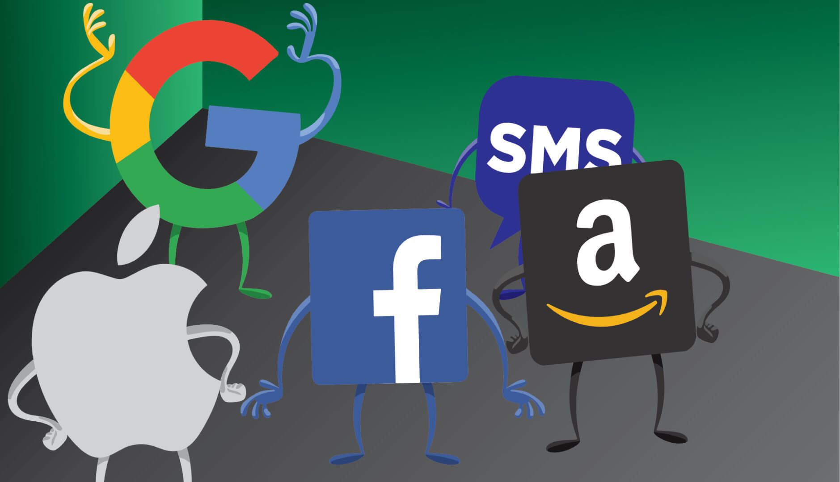
THREATS
Facebook and Instagram dominance in social media platform
The merge between Microsoft and Yahoo to compete with Google
Competition from Amazon and Apple company
Google search engine instability
Decline in its market share in the U.S
OPPORTUNITIES
Entry to the Chinese market
Adoption of artificial intelligence
Unveiling a self-driving vehicle
Alternative energy sources
Partnering with other firms to improve software
Expansion of its services to new markets by developing new distribution chains
Notes:
Google Company can expand its technological product due to the integration of technology in many spheres of the world, such as homes, vehicles, and mobile devices. The company is likely to develop its artificial intelligence in real-life situations such as health care. The biggest threats of Google are Facebook and Instagram, which have over one billion users, and offering services such as advertisement, and post promotion. Facebook and Instagram are also offering similar services like Google for instant promotion through ads.

Slide 5

IMPROVE ITS COMPETITIVE ADVANTAGE
Google should improve its competitiveness in the market by:
Develop infrastructure that warrants efficient and fast search engine
Expand its products such as android operating system mobile phones
Setting a competitive price on its products, e.G., Reducing its product prices in different markets
Safeguarding its strategic assets such as trade name
Notes:
Google should enhance its search engine to prevent its customers from using other applications from its rival, such as Microsoft edge. Its search engines' speed can be improved by building its storage system, hardware, and servers (Brandimarte, 2017). At the same time, Google should increase its investment in mobile devices, ensuring that its product reaches the majority of the markets.

Slide 6

ENHANCE CUSTOMERS' SATISFACTION
Googles should improve its customers' satisfaction by:
Protecting customers' data collected through its application
Improving its customers' services by responding to customers on time
Providing its customers with perfect products all the time
Improving its customer engagement using multiple channels, e.G., Social media
Notes:
Google Company should improve its customer service by deploying workers who will take care of customers when serving them (Ramanathan, Subramanian, & Parrott, 2017). For example, Google should hire employees who will assist the customers on time and faster. Preserving customers' privacy on data collected while using the Google application will increase customer satisfaction since it will increase their trust.

Slide 7

Establish new markets
Google company should establish new markets in china due to:
China has a large population; hence more product and service will be consumed
China has excellent infrastructure such as technology and business network
The political and economy of china is stable, which will enhance business performance
Over the past years, China has invested hugely in information technology hence have ready markets for google products.
Notes:
Google should open up its new market segment in the country, such as China. This will help the company increase its customer, enhance its revenues through increased sales and promote its growth through profitability. Some of the methods Google can utilize to enter a new market like China include joint venture, partnership with local business, and direct shipping.

Slide 8

CONCLUSION
Google company was founded in 1998
Google has an excellent brand reputation
Google should:
Improve its competitive advantage
Enhance customers' satisfaction
Establish new markets
Notes:
The main strengths of Google Company are widely recognized brand, excellent brand reputation, large market share in the U.S, and dominates the online search engine. The company can improve its customer's satisfaction by protecting their privacy and provision of perfect products.

Slide 9
REFERENCES
Brandimarte, E. (2017). Competition in high technology markets: multi-sided platforms and google antitrust case.
Dolata, u. (2017). Apple, amazon, google, facebook, microsoft: market concentration-competition-innovation strategies (no. 2017-01). SOI discussion paper.
Hassler, s. (2020). Google has nest. Amazon has echo and alexa. Savant systems has—ge lighting! The luxury home-automation company has its sights set on high-quality mass-market home networking-[spectral lines]. IEEE spectrum, 57(7), 04-04.
Ramanathan, u., Subramanian, N., & Parrott, G. (2017). Role of social media in retail network operations and marketing to enhance customer satisfaction. International journal of operations & production management.

