Slide 1
Technology in the 21st Century Assignment
Name
Institution
Course
Professor
Date

Slide 2

Use of Computers and databases in the 21st Centuries among Organizations
Communication processes are at the center of the position of computers and databases among organizations.
It serves as the best framework for enhancing the proper outcomes.
The main reason is that it ensures businesses remain relevant among different markets.
To begin with, external and internal communications are made possible.
Employees use computers to promote sharing of information with different stakeholders.
It is crucial in enabling a platform that ensures customers
access information regarding different products and services (Abdeldayem & Aldulaimi, 2020).
Notes:
Communication processes are at the center of the position of computers and databases among organizations. It serves as the best framework for enhancing the proper outcomes. The main reason is that it ensures businesses remain relevant among different markets. To begin with, external and internal communications are made possible. Employees use computers to promote sharing of information with different stakeholders. These stakeholders comprise employees, management, customers, and governments (Stylos et al., 2021). Computers have emails, conferencing, and messenger systems, among others. Secondly, computers connected to the internet can promote significant development in terms of advertisements and marketing. It is crucial in enabling a platform that ensures customers access information regarding different products and services (Abdeldayem & Aldulaimi, 2020). It connects databases of different products and services within markets. Concerning databases having the right information concerning products and services, both customers and employees can use this as a position to initiate significant growth

Slide 3
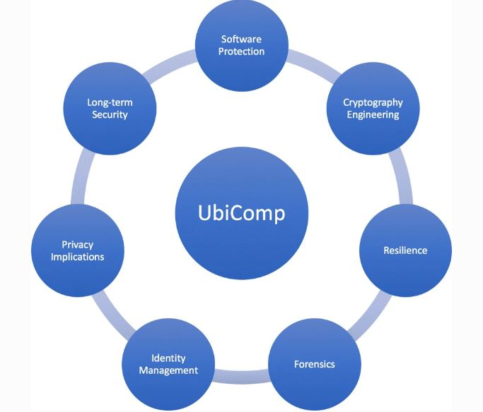
Use of Computers and databases in the 21st Centuries among Organizations
It connects databases of different products and services within markets.
Concerning databases having the right information concerning products and services, both customers and employees can use this as a position to initiate significant growth.
Knowledge associated with the gaps makes it possible to initiate positive developments when it comes to the operations of these companies.
It is crucial to note that computers have advanced in the last four decades, with them aligning business needs and product alignments with the interests of markets where companies operate.
Notes:
The sharing of information among organizations and their stakeholders is the most significant process undertaken at any given point. Therefore, stakeholders can always look for outlets to share crucial information regarding products and services. Computers and databases are important in initiating a new edge of competition among businesses (Abdeldayem & Aldulaimi, 2020). Going through them can initiate an understanding of knowledge concerning products and services. Companies can know different gaps associated with sales among the databases (Kenney & Zysman, 2019). Knowledge associated with the gaps makes it possible to initiate positive developments when it comes to the operations of these companies. It is crucial to note that computers have advanced in the last four decades, with them aligning business needs and product alignments with the interests of markets where companies operate. With the new millennium, companies ensure effective decision-making by aligning different analytical frameworks among businesses and their companies. With the advancement of computers and networks in the market, databases are changing, taking a cloud computing framework.

Slide 4
References
Abdeldayem, M. M., & Aldulaimi, S. H. (2020). Trends and opportunities of artificial intelligence in human resource management: Aspirations for public sector in Bahrain. International Journal of Scientific and Technology Research, 9(1), 3867-3871.
Kenney, M., & Zysman, J. (2019). Unicorns, Cheshire cats, and the new dilemmas of entrepreneurial finance. Venture Capital, 21(1), 35-50.
Stylos, N., Zwiegelaar, J., & Buhalis, D. (2021). Big data empowered agility for dynamic, volatile, and time-sensitive service industries: the case of tourism sector. International Journal of Contemporary Hospitality Management.

