Slide 1

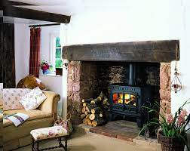
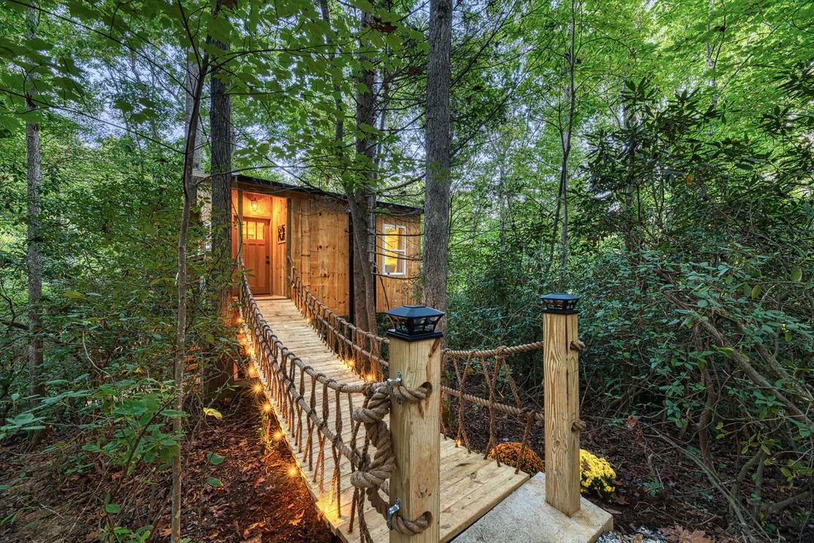

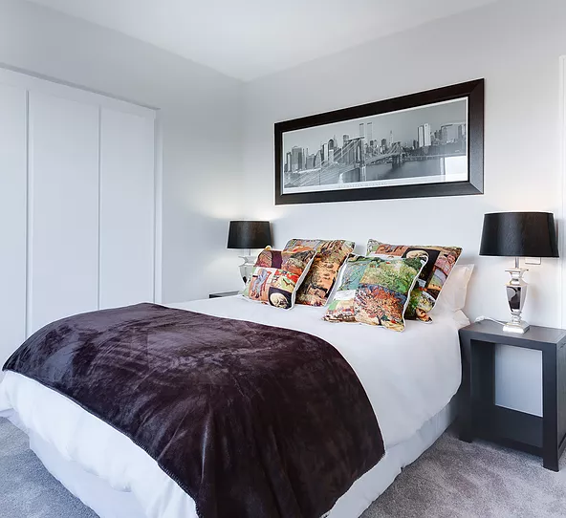
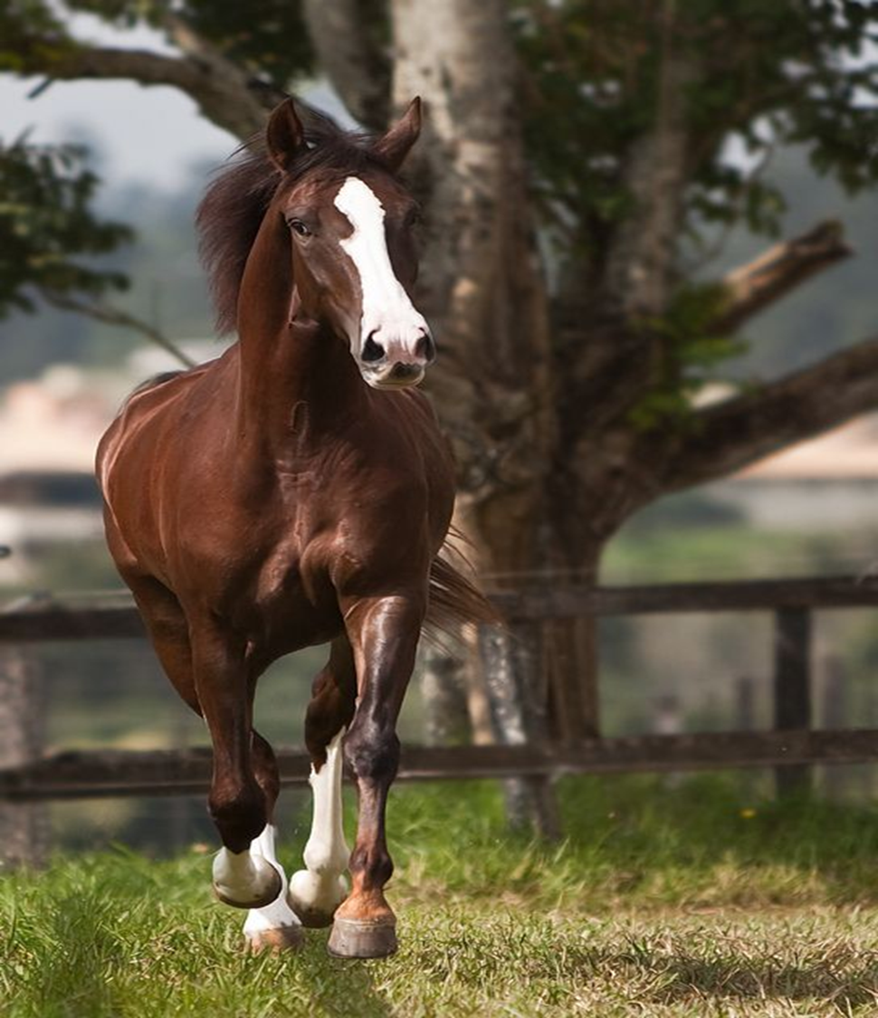


Serenity INN
Business Plan

Slide 2

Executive summary
Serenity Inn Bed and Breakfast in a vineyard is located in 500 Terry Francois St. San Francisco, CA 94158.
The business is located on 80 serene acres surrounded by a vineyard, mountains and hardwood forests.
The business provides special services as secluded chalets providing customers with unquestionable privacy which has greatly given it a great competitive advantage.
The business goes ahead to improve the experience and offers additional free outdoor activities as horse riding and hot air balloons.
The experience brought about by Serenity Inn is quite magical and is Utopia for anyone who intends to find a place to relax and bond with nature.

Slide 3
Business Description
Serenity-inn bed and breakfast is located in San Francisco.
It is a unique destination covering 80 serene acres surrounded by grapevine yards, mountains and hardwood forests.
Our services include
  Accommodation
  Delicious foods
Our special services include;
  Secluded chalets providing customers with an opportunity to make their own food and wine,
  Cottages fitted with a wood burning fireplace creating a cozy wit, and
  Outdoor fun activities as hot air balloons and horse riding.

Slide 4
Cont.… Business Description
Serenity inn bed and breakfast falls under the hospitality sector.
The hospitality sector has been performing well over the years until recently when Covid 19 set in.
Travel restrictions and skepticism of the population greatly affected the sector and most lodging businesses continue counting losses (Sönmez et al 2020).
However, there is very high expectations of better days ahead as most nations continue easing restrictions on movement (Grusoy & Chi 2020).
The recent bill amendments on wine and alcoholic beverages is expected to be of great relief to the business (Berger 2020).

Slide 5
Market and competitors
Our target population is the middle and high class population in the country.
We target the working class population, and retired who intend to get rid of stress and have a personal time to bond with nature and enjoy.
Our competitors include; Brampton Inn, Nobnocket Inn, Portland White house, and Ballston Luxury Inn
These competitors have aggressive marketing strategies through social media and directly messaging loyal clients.
Nonetheless, we offer highly distinguished services as secluded chalets, and outdoor fun activities.
We are located on 500 Terry Francois St. San Francisco, CA 94158.
This is an ideal location having a vast land and beautiful sceneries.

Slide 6
Marketing and sales
Pricing
1. Accommodation
  King rooms $50 per night
  Queen rooms $45 per night
  Standard rooms $38 per night
  Accommodation is inclusive of breakfast and outdoor activities. Dishes are charged separately.
  Starters $2 - $10
  Main dish $7.5 - $15

Slide 7
Cont...Marketing and sales
Social media
Direct messaging clients through emails and phone text messages to inform them of any offers, discounts or new developments.
Twitter – create hashtags based on current events.
Tiktok- create short videos on the serenity of the environment and actual people having fun.
YouTube – Create short videos to raise awareness of Serenity inn Bed and Breakfast in a vineyard.
Facebook and blogs – Post beautiful professional photos and videos of the various beautiful places within the serene environment.
Website– Post customer feedbacks and reviews.

Slide 8
Financial Projections
Start up costs
  Equipment, $1,500,000
  Marketing, $130,000
  Facility, $2,200,000
  Permits, $150,000
  Overhead, $240,000
  Labor and $750,000
  Incidentals $145,000
The funds will be sourced partly through personal savings and the rest through a bank loan.
We intend to break even during the 31st month after operations and after having generated a revenue of 24 million to cover our initial expenses and finance the bank loan.

Slide 9
Cont.…Financial Projections
Income projections for the first year
Revenue $1,600,000
Expenses $ 780,000
Profits $ 820,000
Income projections second year
Revenue $4,500,000
Expenses $ 930,000
Profits $ 3,570,000

Slide 10
Operations
CEO- (Name and brief background & include skills eg aggressive or innovative)
Personnel need and staffing
  2 Managers, $20/hour
  At least 12 security guards, $14/hour
  At least 7 field workers, $12/hour
  At least 6 room attendants, $ 15/hour
  At least 5 cooks, and $12/hour
  At least 3 waiters. $12/hour

Slide 11
Operations
Insurance
  Third party insurance,
  Workers compensation insurance,
  Liability insurance, and
  Business property insurance.

Slide 12
References
Gursoy, D., & Chi, C. G. (2020). Effects of COVID-19 pandemic on hospitality industry: review of the current situations and a research agenda.
Sönmez, S., Apostolopoulos, Y., Lemke, M. K., & Hsieh, Y. C. J. (2020). Understanding the effects of COVID-19 on the health and safety of immigrant hospitality workers in the United States. Tourism Management Perspectives, 35, 100717.
Berger, M. S. (2020). IN WINE COUNTRY (Doctoral dissertation, University of California, San Francisco).

Slide 13

END

