Slide 1
Organizational Change
Organizational Change
Student’s Name
Department, Institutional Affiliation
Course Number and Name
Instructor’s Name
Date

Slide 2

Focus on Organizational Change
The agenda for the topic entails issues associated with organizational change, including its significance to all stakeholders.
Organizational change enables firms to succeed and grow, a situation that requires the utilization of new strategies.
Notes:
The issue of change in the organization emerges due to internal or external forces. Irrespective of the nature of the changes, the issues occur at the right time and help managers to learn new things. In this case, the Covid-19 pandemic has forced firms to adjust to new ways of operations due to the restrictions in place.
While the pandemic forced many organizations to change the way they operate, change helps a firm to grow and expand. The issue of organizational change requires management teams to adopt new strategies that facilitate the continuity of operations (Al-Haddad & Kotnour, 2015). All stakeholders involved have to agree or embrace the changes in order to help the firm move forward.

Slide 3

Introduction
The organization under consideration moved to a WFH (work from home) model recently due to the pandemic.
The WFH model has proved its significance in bringing success to the organization during the pandemic.
Notes:
As indicated earlier, the issue of organizational change enables the firm to remain competitive and leaders act as agents of change. The company moved to the WFH model, which has brought success despite the challenges associated with the pandemic. However, the pandemic has gone and employees can go back to the office without sacrificing their health and safety.
Despite the challenges that other organizations encountered during the pandemic, the firm under consideration enjoyed success due to the adoption of the WFH model. Due to this experience, the management wants to continue using this model but some employees want to report or work from the office.

Slide 4
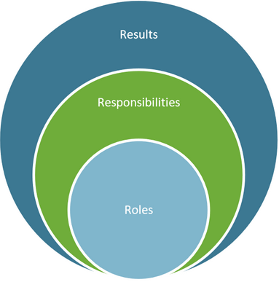
Most Effective Leadership Styles
The adoption of transformative and servant leadership styles would help to continue the success of the WFH model.
The two types of leadership styles engage all stakeholders, including employees, which can encourage the suggested changes.
Notes:
The utilization of transformational leadership approach allows the leader or manager to work with teams in the workplace to identify or establish the need for change (Sun & Henderson, 2017). The process facilitates the creation of a vision that guides change through inspiration, which applies to the current situation of the organization under consideration.
Equally, the use of servant leadership style gives the leader or manager the opportunity to serve others (Gandolfi & Stone, 2018). The style requires the leader to listen to the needs of others, which could help the organizational employees embrace the WFH model. As highlighted, the two leadership styles engage employees directly, which makes them part of the change process.

Slide 5

Managers’ Tactics to Influence Behaviors
Managers can use tactics such as behavior modeling and constructive feedback in order to influence individual conducts within the firm.
The adoption of such tactics would convince all employees to “buy-in” and support the WFH model.
Notes:
The organization’s managers can adopt the use of behavior modeling approach to influence decisions of employees regarding the issue of WFH model. Equally, the element of constructive feedback encourages employees to work hard and follow the organization’s directions (Secchi, 2015). In this context, the use of the two approaches can help to convince some of the managers from moving back to the office.
The use of constructive feedback and behavior modeling can help all employees to understand the advantages of the WFH model. For example, employees will not have to incur commuter expenses and will start working on time every day due to minimal movements. Therefore, the WFH model will play a significant role in improving employee overall performance.

Slide 6
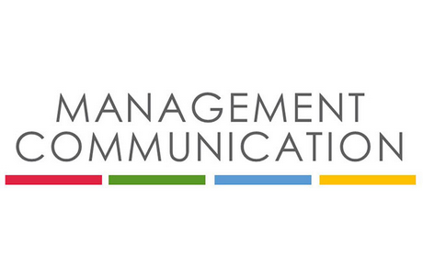
Cont’d
The adoption of regular communication using the appropriate channels can influence individual conducts within the organization.
Equally, other tactics that managers can use include personal appeals, consultations, and forming coalitions or teams with employees.
Notes:
Regular communication across all the organization’s departments ensures that all employees understand and appreciate the organization’s goals, vision, and intentions (Rodrigues, Azevedo, & Calvo, 2016). The situation makes employees feel appreciated by the firm’s leadership. The utilization of appropriate communication channels allows employees to engage the management and provide ideas that can help to influence change.
The organization’s management can use other tactics to engage all employees, such as consultations, creating coalitions, and personal appeals. In this case, the management seeks the adoption of the WFH model. Therefore, the management can convince employees to accept the change but meet twice a month physically in the organization’s conference room.

Slide 7

The Importance of Managers’ Contribution
Every manager helps to provide leadership to others, which could help the organization’s employees embrace the WFH initiative.
The desire to adopt the WFH model would require the managers to set clear goals that would enable employees to appreciate WFH.
Notes:
Managers play an essential role in organizations because the leaders provide instructions and directions for others to follow (Uvhagen, Hasson, Hansson, & von Knorring, 2018). In this case, the managers’ leadership would help the organization’s employees to embrace the WFH model. The managers can convince all workers about the significance of WFH, such as few distractions and reduced expenses because of commuting.
The issue of influencing change in the organization requires managers to set clear goals, including setting an example for others to follow. Through such activities, the organization’s employees will embrace the WFH initiative, which will lead to increased productivity due to few distractions and workers’ ability to focus on issues that matter.

Slide 8

Cont’d
The managers’ conduct that focuses on the coordination of employees’ activities and delegating responsibilities would lead the organization through the WFH initiative.
Equally, the involvement of employees in decision-making processes would help to embrace new changes such as the WFH model.
Notes:
The process of initiating change in the organization succeeds if the management engages all stakeholders. In this case, managers’ conduct that involves the coordination of employee activities, including the delegation of duties makes them feel appreciated in the workplace (Juarez Tarraga, Santandreu Mascarell, & Marin Garcia, 2019). As such, managers’ ability to treat employees as part of the firm would help the organization go through with the WFH initiative.
Employees play a significant role in organizations. Managers’ involvement of employees in key decision-making processes would help the organization succeed with the WFH initiative. Therefore, the managers should engage employees during decision-making procedures, especially when initiating change.

Slide 9

Conclusion
The management can convince all employees to embrace the WFH model by engaging them during the change process.
The adoption of transformative and servant leadership styles could help managers to convince employees accept WFH.
Notes:
All organizations should engage employees in the decision-making process, especially when initiating changes because such activities affect workers. In the case of the organization under consideration, engaging employees will help to developing a positive relationship. The situation will make employees feel appreciated, which will convince them to embrace the WFH initiative.
Managers’ adoption of transformative and servant leadership styles will convince employees to embrace the change because of the benefits associated with the WFH model. The leadership styles will involve engaging employees in all activities, including forming teams and alliances with the management to as a way of overseeing the change process.

Slide 10
References
Al-Haddad, S., & Kotnour, T. (2015). Integrating the organizational change literature: a model for successful change. Journal of Organizational Change Management, 28(2), 234-262.
Gandolfi, F., & Stone, S. (2018). Leadership, leadership styles, and servant leadership. Journal of Management Research, 18(4), 261-269.
Juarez Tarraga, A., Santandreu Mascarell, C., & Marin Garcia, J. A. (2019). What are the main concerns of human resource managers in organizations?. Intangible Capital, 15(1), 72-95.
Rodrigues, A., Azevedo, C., & Calvo, V. (2016). Internal communication in organizations: Practical instruments to help the shift change. Millenium-Journal of Education, Technologies, and Health, 105-114.

Slide 11
Cont’d
Secchi, D. (2015). A case for agent-based models in organizational behavior and team research. Team Performance Management, 21(1/2), 37-50.
Sun, R., & Henderson, A. C. (2017). Transformational leadership and organizational processes: Influencing public performance. Public Administration Review, 77(4), 554-565.
Uvhagen, H., Hasson, H., Hansson, J., & von Knorring, M. (2018). Leading top-down implementation processes: A qualitative study on the role of managers. BMC Health Services Research, 18(1), 1-9.

